Slide 1
Events
Karl Shifflett
Program Manager, Microsoft patterns & practices

Slide 2
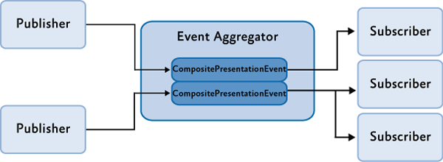
Event Aggregator 101
Enables communication between loosely coupled components
Publishers and subscribers communicate through the Event Aggregator without having a reference to each other
Events are strongly typed

Slide 3
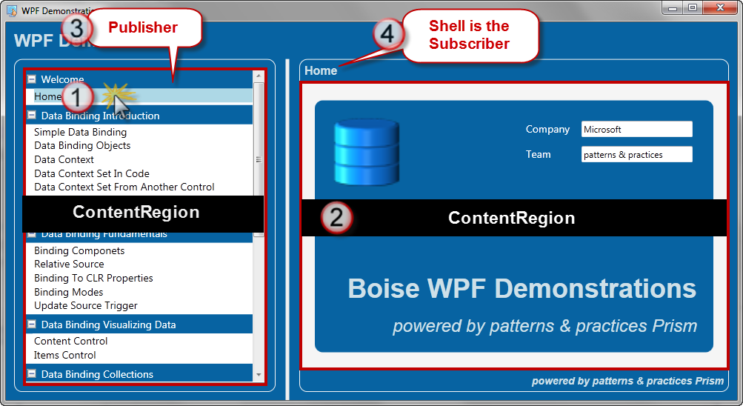
Pub/Sub Walkthrough
Navigation region item clicked
Content region navigated
LessonSelectedEvent published, the payload is the title
LessonSelectedEvent subscriber invoked
Title TextBlock text updated using payload string value

Slide 4
Demo
Publish and Subscribe
Stock Trader RI
Wpf.Demonstrations ShellView

Slide 5
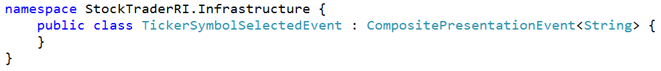
Creating an Event
Defined in a common assembly to enable cross-module pub/sub
Naming convention {event name}Event
Derived from CompositePresentationEvent<T>
Provides payload for passing an object from the publisher to one or more subscribers

Slide 6
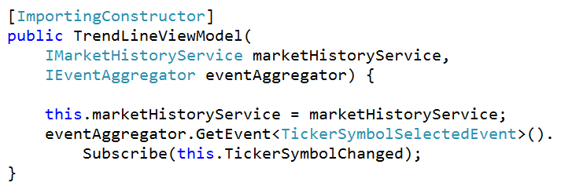
IEventAggregator
Event aggregator added to container during bootstrapping
Is passed in the constructor of consumer classes that publish or subscribe to events

Slide 7
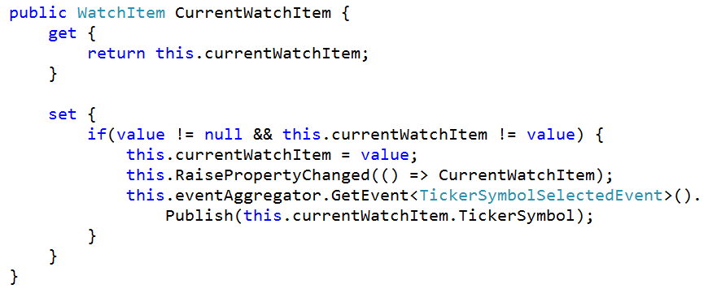
Publishing an Event
Publish the event passing the TickerSymbol as the payload.

Slide 8
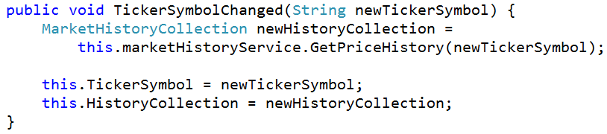
Subscribing to an Event
Subscribing to an event using the default minimum method signature that requests a callback.

Slide 9
Subscribe Overloads
public SubscriptionToken Subscribe(Action<TPayload> action);
public SubscriptionToken Subscribe(Action<TPayload> action, ThreadOption threadOption);
public SubscriptionToken Subscribe(Action<TPayload> action, bool keepSubscriberReferenceAlive);
public SubscriptionToken Subscribe(Action<TPayload> action, ThreadOption threadOption, bool keepSubscriberReferenceAlive);
public virtual SubscriptionToken Subscribe(Action<TPayload> action, ThreadOption threadOption, bool keepSubscriberReferenceAlive, Predicate<TPayload> filter);

Slide 10
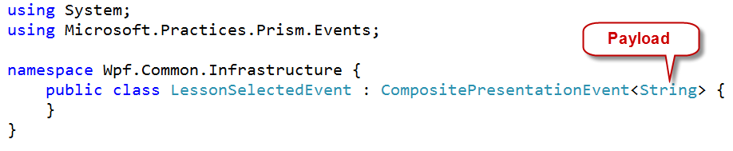
Creating another Event
Let’s walk through one more pub/sub example

Slide 11
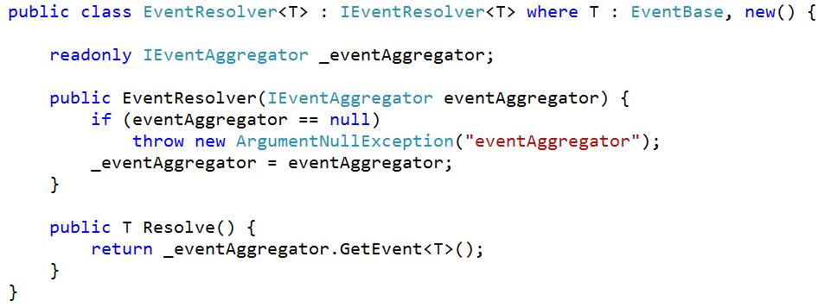
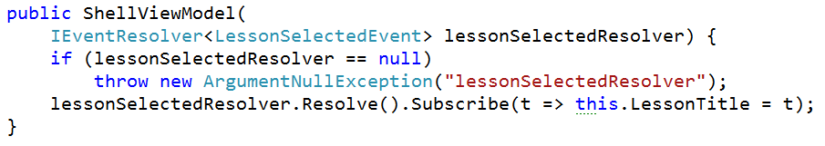
IEventResolver<T> (declares intent)
Declaring intent in the constructor, self documents the code

Slide 12
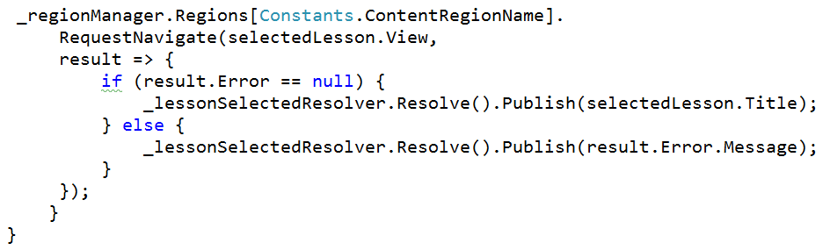
Publishing an Event
When the navigation completes, the below callback checks if it was successful, if so the lesson title is passed in the payload, otherwise, exception message is passed in the events payload.
Notice the slightly different syntax, rather than getting the event from the Event Aggregator, the resolver only allows access to a single event.

Slide 13
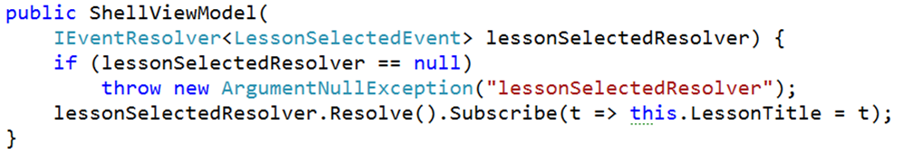
Subscribing to an event using the default minimum method signature that requests a callback.
Notice the slightly different syntax, rather than getting the event from the Event Aggregator, the resolver only allows access to a single event.

Slide 14
Demo
Event Aggregator
(Publisher) Wpf.Presentation
(Subscriber) Wpf.Demonstrations

Slide 15
Contact
Twitter: @kdawg02
Blogs
http://karlshifflett.wordpress.com/
http://blogs.msdn.com/b/kashiffl/
http://blogs.msdn.com/b/wpfsldesigner/
Links
http://compositewpf.codeplex.com/
http://msdn.microsoft.com/en-us/practices/default.aspx

Slide 16


